Slide 1
Self Driving RC Car
Ethan Wells
Abigail Duran
Ethan Bishop
Alexis Perez

Slide 2
Ethan Wells
Goals for the week
  Prepare the LISA dataset (US traffic signs) for training.
  Test the trained German-sign (GTSRB) model.
Progress for the week
  Neither machine-learning goal was started — getting the CM5 ready for hardware testing took priority so the team has a working board to bench-test sensors on.
  Assembled the CM5 on the Compute Module 5 IO Board with the ZDE heatsink/PWM fan, CR2032 RTC cell, and 27 W USB-C power supply.
  Flashed Raspberry Pi OS Lite (64-bit) to the 128 GB KIOXIA NVMe SSD and booted the CM5 from M.2.
  Brought up headless SSH over the USB Wi-Fi dongle (the CM5 has no onboard wireless).
  SSH over Wi-Fi was painfully slow; traced it to the dongle’s stock driver and replaced it with a working RTL8188EUS build.
  Wrote setup.sh, a one-command install of the shared software prerequisites (git, python3, pip, venv) so anyone can start from the same baseline.
  Purchased the remaining compute parts: NVMe SSD, USB NVMe enclosure, heatsink + PWM fan, 27 W power supply, CR2032 battery, and TP-Link Wi-Fi dongle.
Goals for next week
  Prepare the LISA dataset (US traffic signs) for training.
  Test the trained German-sign (GTSRB) model.
Hours spent on progress
  7 hours.

Slide 3
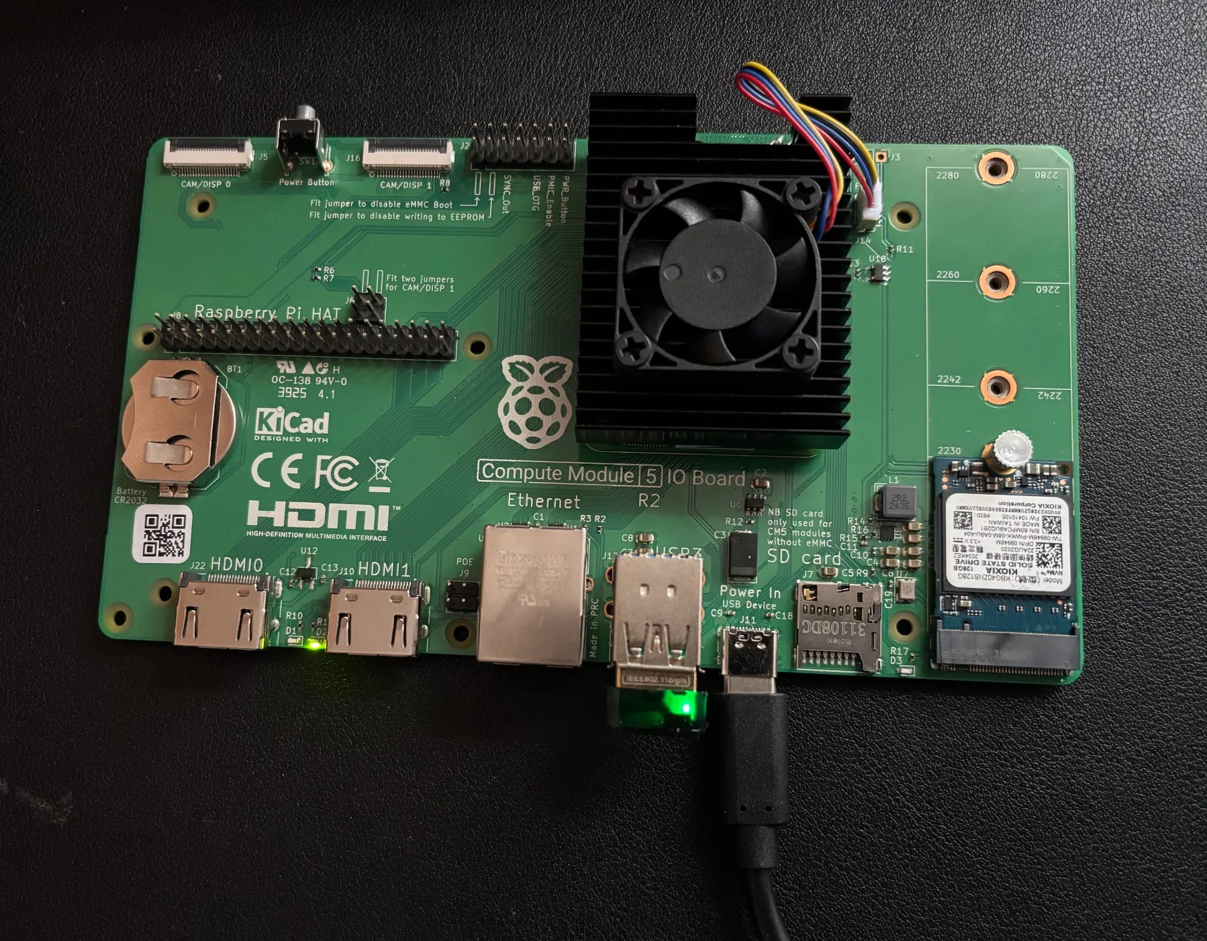
CM5 Bring-Up
• CM5 seated on the Compute Module 5 IO Board
• Heatsink + PWM fan, CR2032 RTC cell, 128 GB NVMe SSD in the M.2 slot
• Powered by the 27 W USB-C supply; boots Raspberry Pi OS Lite (64-bit) from NVMe
• Accessed headless over SSH through the USB Wi-Fi dongle

Slide 4
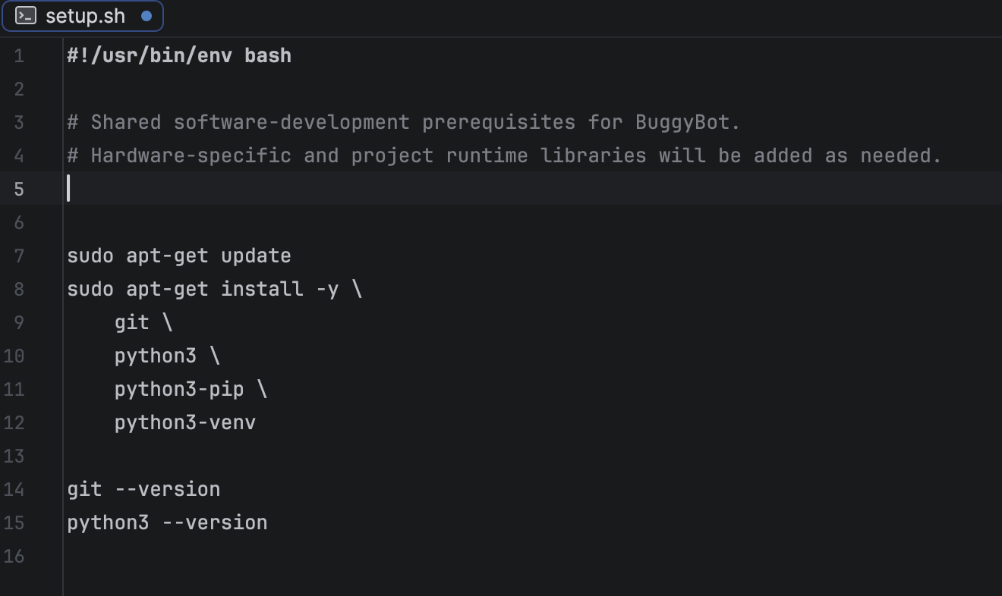
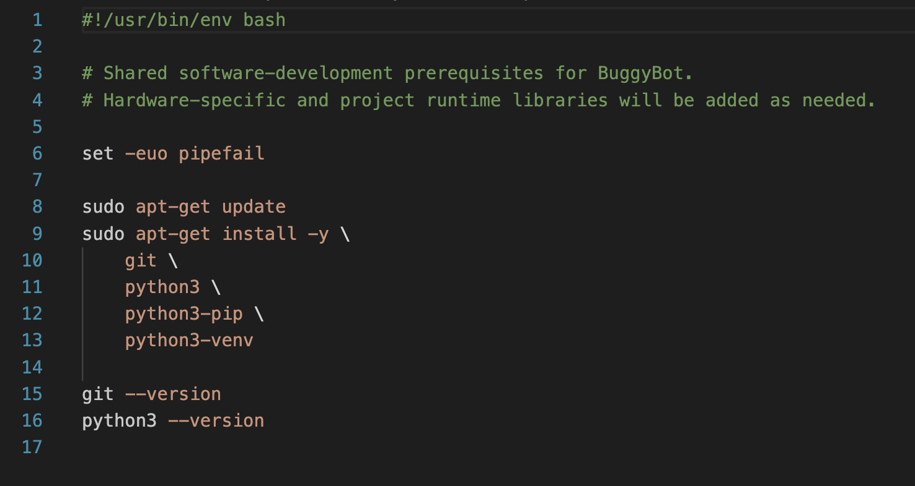
Development Environment Setup
• Wrote setup.sh so anyone can bring a board to the same baseline with one command
• Installs the shared prerequisites: git, python3, pip, and venv
• Prints the git and python3 versions at the end to confirm the install worked
• Hardware-specific and runtime libraries (camera, GPIO, TensorFlow Lite) get added as the project needs them

Slide 5
Alexis Perez
Goals for the week
  Implement ultrasonic sensor onto Raspberry Pi
  Test motors and motor controller
  Research battery/power supply options
Progress for the week
  Finalized ultrasonic sensor implementation on Raspberry Pi
  Tested motors and motor controller for performance
  Determined hardware power requirements for future battery/power supply selection
Goals for next week
  Select replacement motors/controller if needed
  Narrow down battery/power supply options
Hours spent on progress
  7 hours.

Slide 6
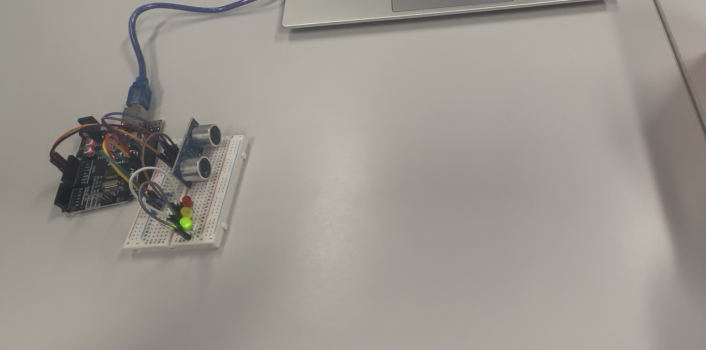
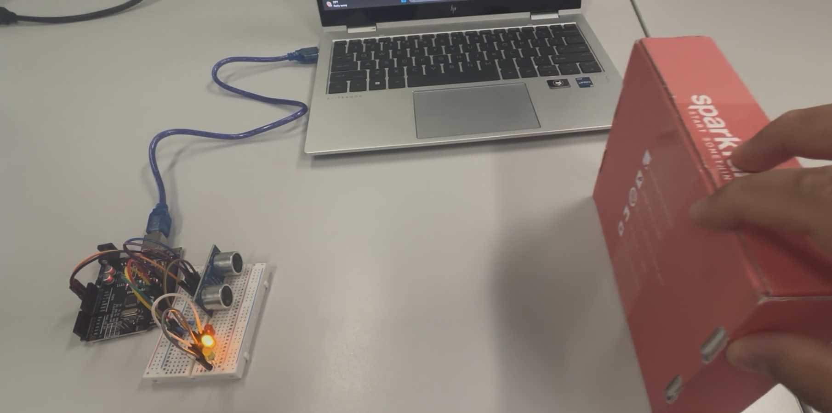
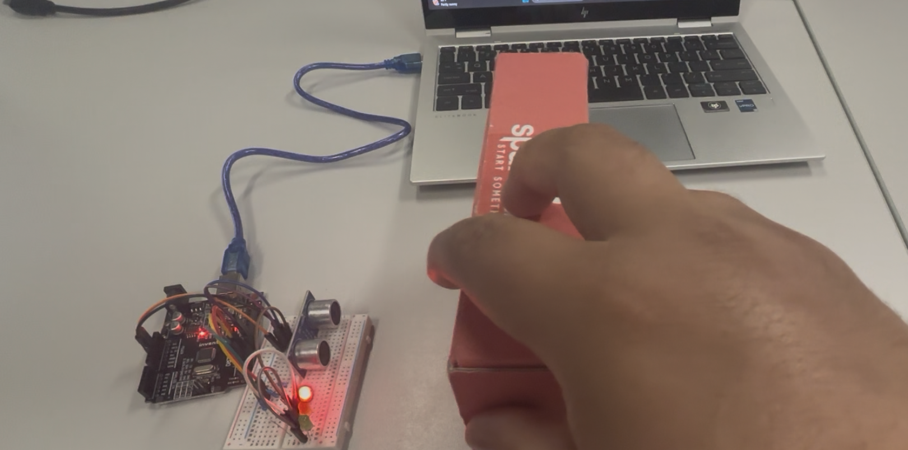
Ultrasonic Sensor Testing
Additional testing for distance readings and range
Finalizing ultrasonic sensor implementation on Raspberry Pi

Slide 7
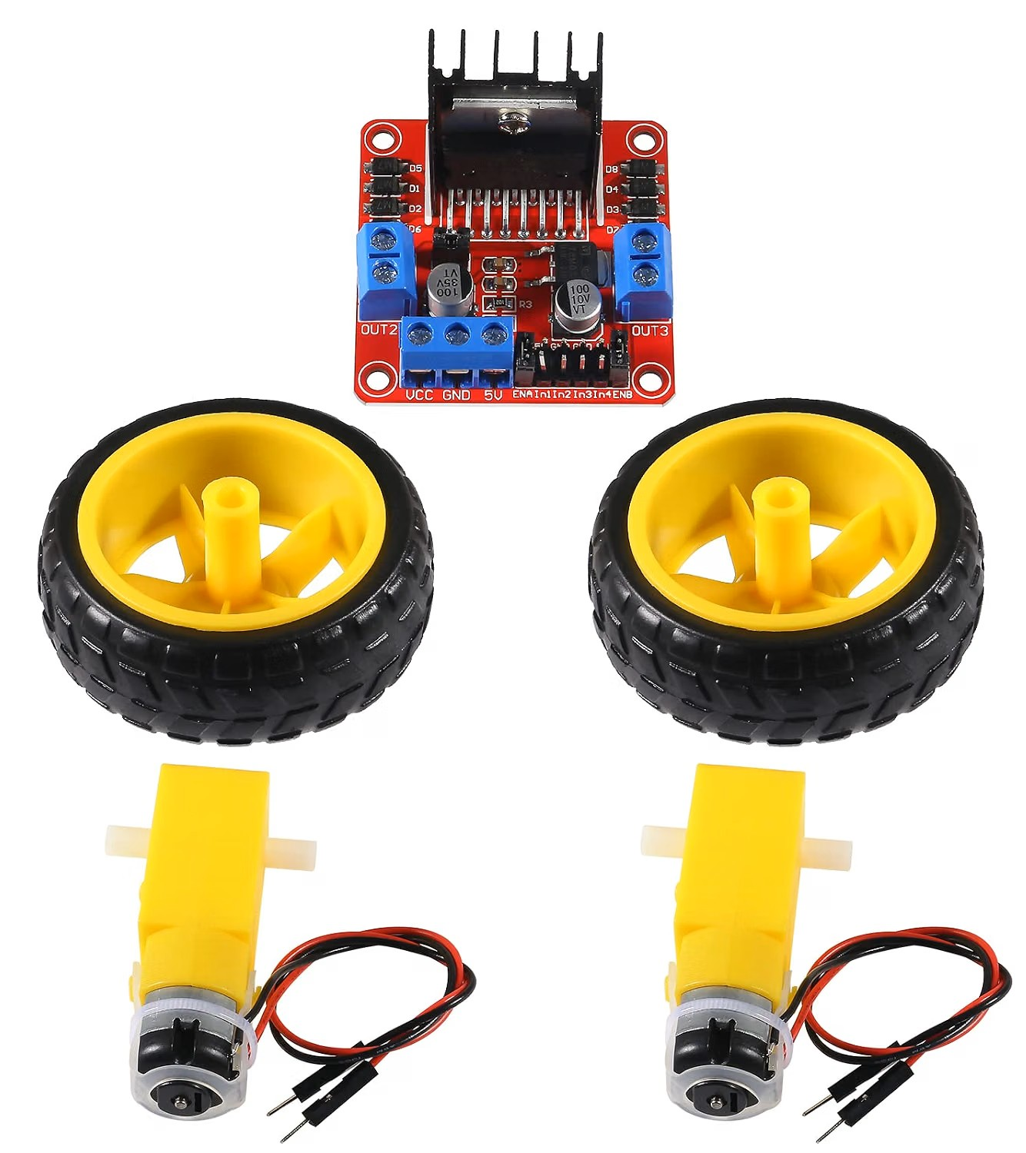
Motors and Motor Controller
Ordered motors and motor controller
  L298N Motor Controller
  2x TT-Style DC motors
Tested motors/controller for performance
Identified issues with current components
Considering replacement motor/controller options

Slide 8
Ethan Bishop
Goals for the week
  Test Pi HAT motor controllers
  Write code to integrate IMU on to Raspberry Pi
Progress for the week
  Wrote code for HAT motor controllers to test for operational accuracy
  Continue implementing IMU on Raspberry Pi
Goals for next week
  Finish testing HAT motor controllers
  Finish IMU implementation on Raspberry Pi
  Research 3D printing stl files for the chassis
Hours spent on progress
  6 hours.

Slide 9
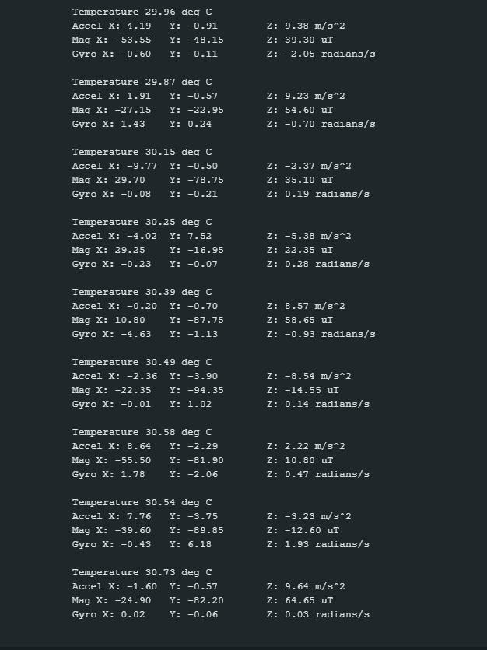
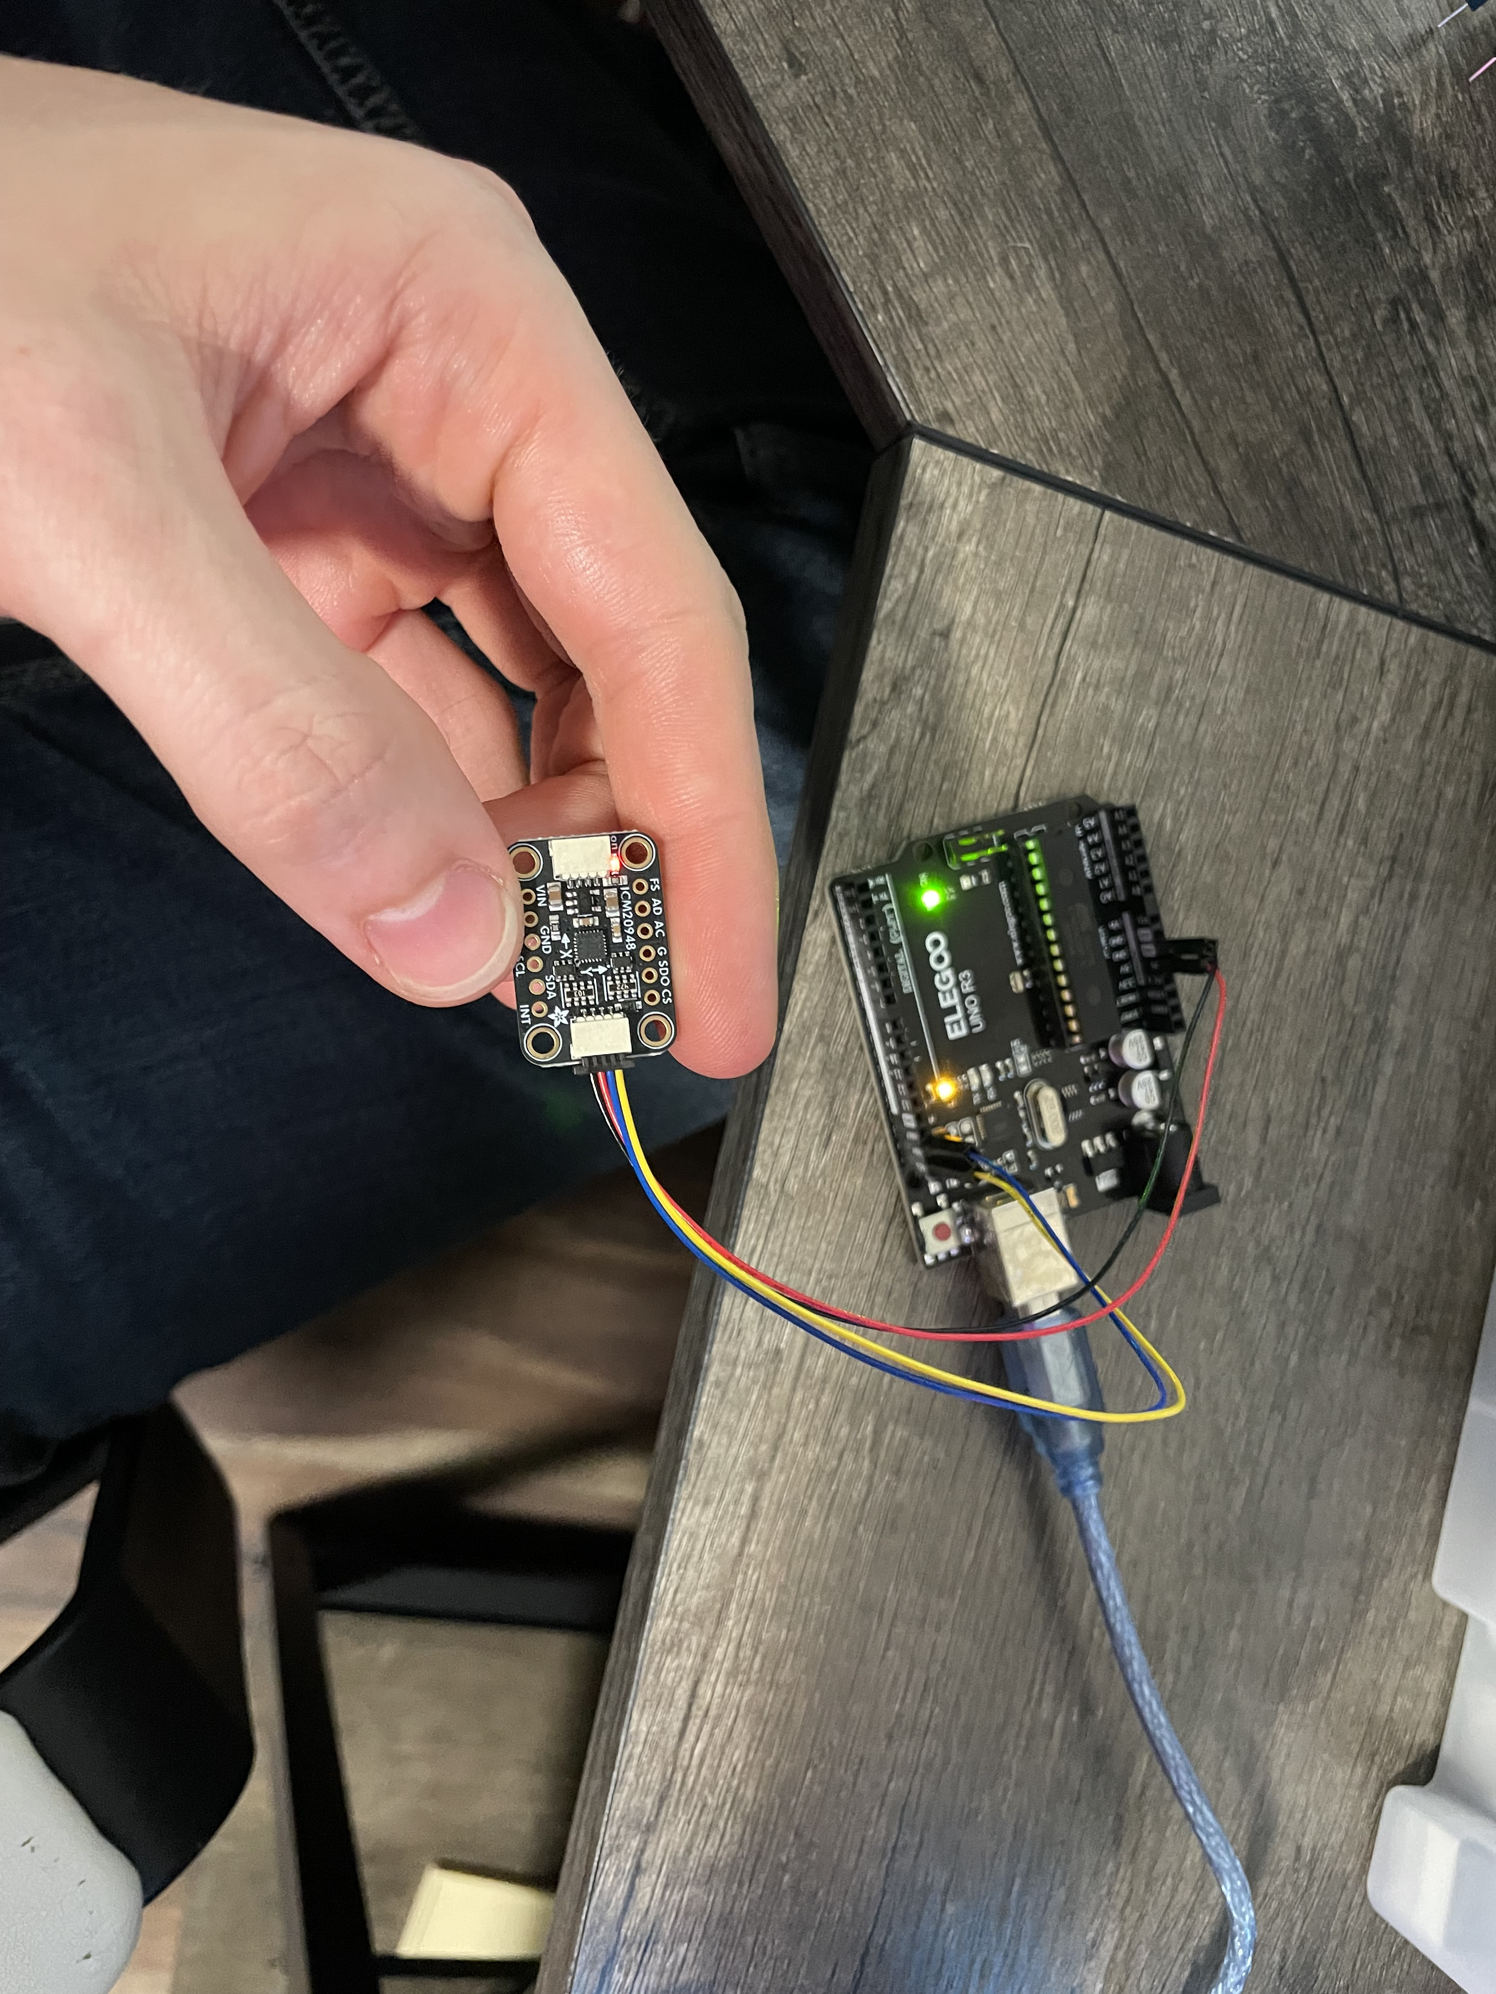
IMU Testing
Verification of the measurements and directions

Slide 10
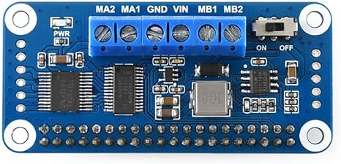
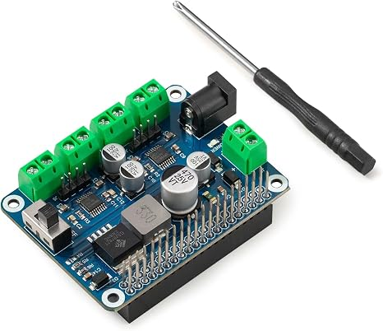
Motor Controller Testing
Ordered Pi HAT motor controllers
  2WD HAT motor controller
  4WD HAT motor controller
Made the motor controller code to test for operational accuracy

Slide 11
Abigail Duran
Goals for the week
  Successfully connect and communicate with the LCD and camera using the Raspberry Pi Compute Module 5.
  Integrate the LCD and camera with the machine learning model to display detected signs and corresponding commands.
Progress for the week
  Prepared the necessary libraries and software for the LCD1602 RGB module.
  Researched camera setup and configuration for the Raspberry Pi Compute Module 5.​​
  Identified the steps needed to integrate the camera and LCD with the machine learning model.​​
Goals for next week
  Continue hardware testing and verify communication between the Raspberry Pi and all connected components.​​
  Determine which components and connections will be included on the final PCB.​
  Begin planning the PCB layout, including component placement and board dimensions.​
  Begin planning power distribution and signal routing.​
Hours spent on progress
  6 hours​

Slide 12
